Slide 1


Expensync
Pitch Deck
Expensync: Simplify Your Spending, Sync Your Savings
https://expensync.netlify.app

Slide 2
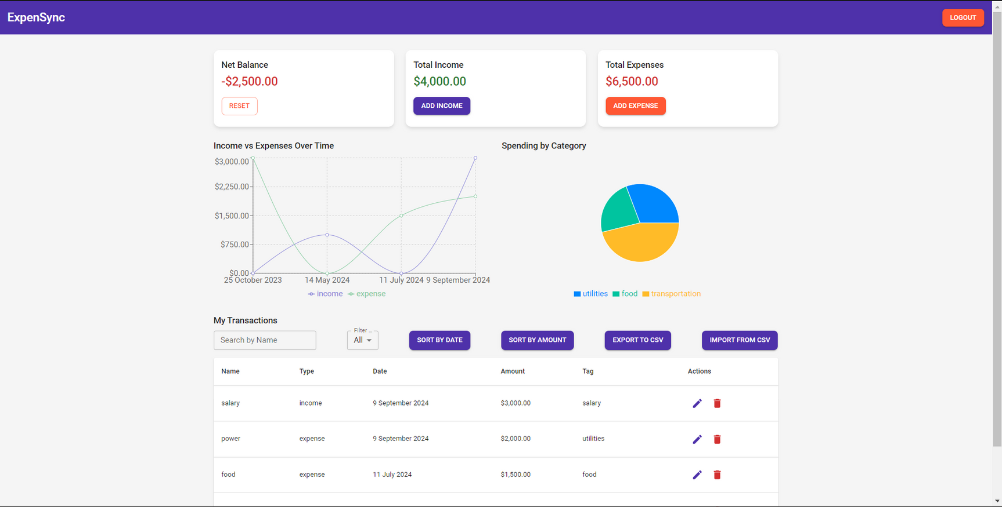

Introduction
Company Overview
Our app offers real-time expense tracking, effortless budgeting, and secure data management to empower you in achieving financial clarity.
Join us and transform how you manage your money today!

Slide 3


Problem
Problem Statement
Managing personal finances can be complex, with challenges in tracking expenses, budgeting, and analyzing spending patterns. Traditional methods often lead to inefficiencies and lack real-time insight
Pain Points
In the presentation session, the background can be filled with information that is arranged systematically and effectively concerning an interesting topic to be used as material for discussion at the opening of the presentation session.
The overwhelming nature of financial management can cause poor budgeting decisions and financial stress. Users need a simple, integrated solution for real-time tracking and actionable insights.

Slide 4


Solutions
Solution 1
ExpenSync Solution
Introducing our Expense Tracker: A user-friendly, data-driven personal finance management tool
Automates expense tracking and categorization
Provides real-time insights into spending habits
Helps users set and stick to budgets
Enables smart financial decision-making through predictive analytics

Slide 5
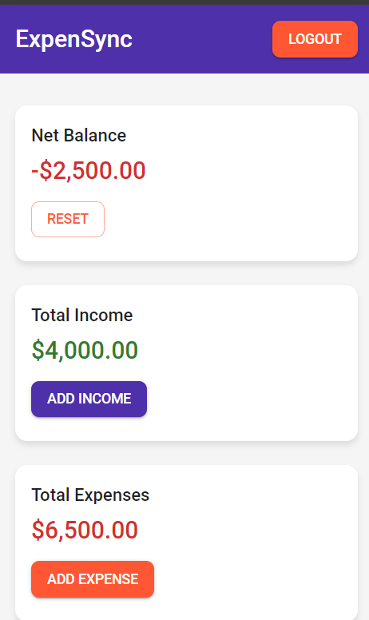
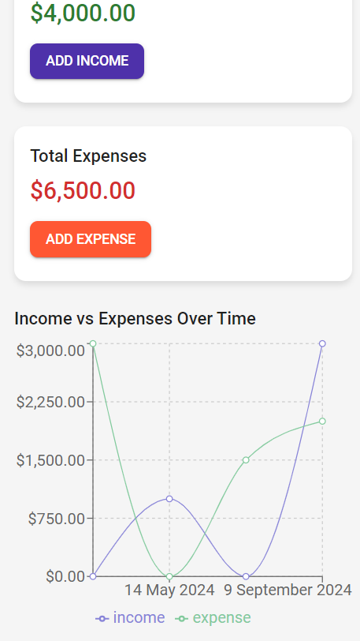
Product
ExpenSync
Mobile and web application for easy access
Features:
Automatic transaction categorization
Custom budget creation and tracking
Visual reports and analytics
Bill reminders and recurring transaction tracking
Multi-currency support
Secure data encryption and user privacy

Slide 6
Target Market
Primary: Young professionals (25-40 years old)
Secondary: College students and budget-conscious families
Tech-savvy individuals looking to improve their financial health
People transitioning to financial independence or major life changes

Slide 7

Market Size
Global personal finance software market size: $1.02 billion in 2020
Expected to reach $1.58 billion by 2027 (CAGR of 6.4%)
Smartphone users worldwide: 6.6 billion in 2022, expected to grow
Increasing focus on financial literacy and personal finance management

Slide 8

Competitors
Mint: Offers comprehensive budgeting, expense tracking, and financial insights, with a focus on account aggregation and budgeting tools.
YNAB (You Need A Budget): Known for its unique budgeting approach and goal-setting features, aimed at helping users gain control over their finances.
PocketGuard: Simplifies expense tracking by showing how much disposable income is available after accounting for bills, goals, and necessities.
EveryDollar: Provides a straightforward budgeting tool with an emphasis on monthly planning and expense tracking.

Slide 9

Competitive Advantage
Why PesaConnect Stands Out
User-centric design focused on simplicity and ease of use
Advanced data analytics for personalized financial insights
Integration with multiple financial institutions and cryptocurrencies
Community features for shared financial goals and advice
Gamification elements to encourage positive financial habits

Slide 10

Traction & Roadmap
Traction
10,000+ active users within 3 months of launch
4.7/5 star rating on Google
Featured in "Top Financial Apps" lists on major tech blogs
Roadmap:
Q3 2023: Launch AI-powered financial advisor feature
Q4 2023: Introduce investment tracking and analysis tools
Q1 2024: Expand to 5 new international markets
Q2 2024: Launch premium subscription model with advanced features

Slide 11

Business/Revenue Model
Freemium model:
Basic features free for all users
Premium subscription ($4.99/month) for advanced features
Data monetization (anonymized, aggregated data sold to financial institutions)
Affiliate partnerships with financial product providers
White-label solutions for banks and financial institutions

Slide 12

Go-To-Market Strategy
Market Penetration Plan
Content marketing focusing on financial literacy and tips
Partnerships with financial influencers and bloggers
Referral program rewarding users for inviting friends
Targeted social media advertising
Collaborations with universities for student outreach
Participation in fintech conferences and events

Slide 13
Social Impact
Expensync contributes to several Sustainable Development Goals (SDGs) through its innovative approach to personal finance management:
SDG 1: No Poverty – By promoting better financial planning and savings habits, Expensync helps individuals manage their resources more effectively, reducing the risk of financial instability and poverty.
SDG 8: Decent Work and Economic Growth – Expensync supports economic growth by empowering users to make informed financial decisions, which can lead to better financial health and productivity.
SDG 10: Reduced Inequality – By providing accessible financial tools and insights, Expensync helps bridge the gap between different income levels, offering everyone a chance to improve their financial literacy and management.
SDG 12: Responsible Consumption and Production – Expensync encourages mindful spending and budgeting, fostering more responsible consumption patterns and efficient resource use

Slide 14

Our Ask
Investment Request
Seeking $2 million in seed funding
Use of funds:
40% for product development and feature expansion
30% for marketing and user acquisition
20% for team expansion (focus on data science and UI/UX)
10% for operational costs

Slide 15




Our Team
At Expensync, our team is dedicated to transforming personal finance management through innovation and expertise:
John Thiongo
Mary Ann
CEO & Founder
Co-Founder/CTO)
Together, our diverse team combines technical expertise, creative vision, and strategic insight to deliver a top-notch financial management solution that meets the needs of our users and drives positive social impact.
Sebastian Atieno
Juliana Mutuku
Lead Designer
Head of Marketing

Slide 16
Contact Us
Address
123 Anywhere St., Any City, ST 12345
Phone Number
+254111384918
Email Adress
johnthiongo@protonmail.com
Website
https://expensync.netlify.app

